Slide 1
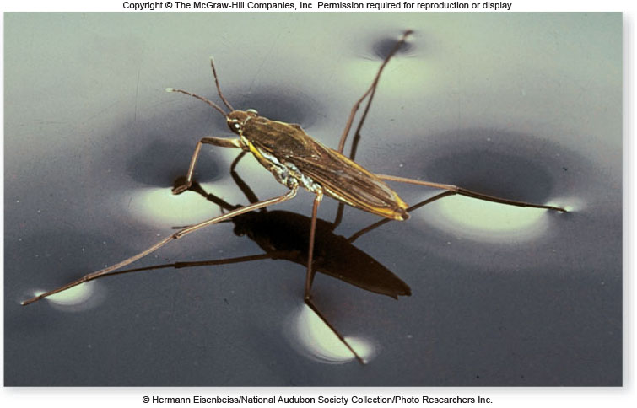
The Nature of Molecules
Chapter 2

Slide 2
Life requires ~25 chemical elements
About 25 elements are essential for life
  Four elements make up 96% of living matter:
    • carbon (C) • hydrogen (H)
    • oxygen (O) • nitrogen (N)
  Four elements make up most of remaining 4%:
    • phosphorus (P) • calcium (Ca)
    • sulfur (S) • potassium (K)

Slide 3
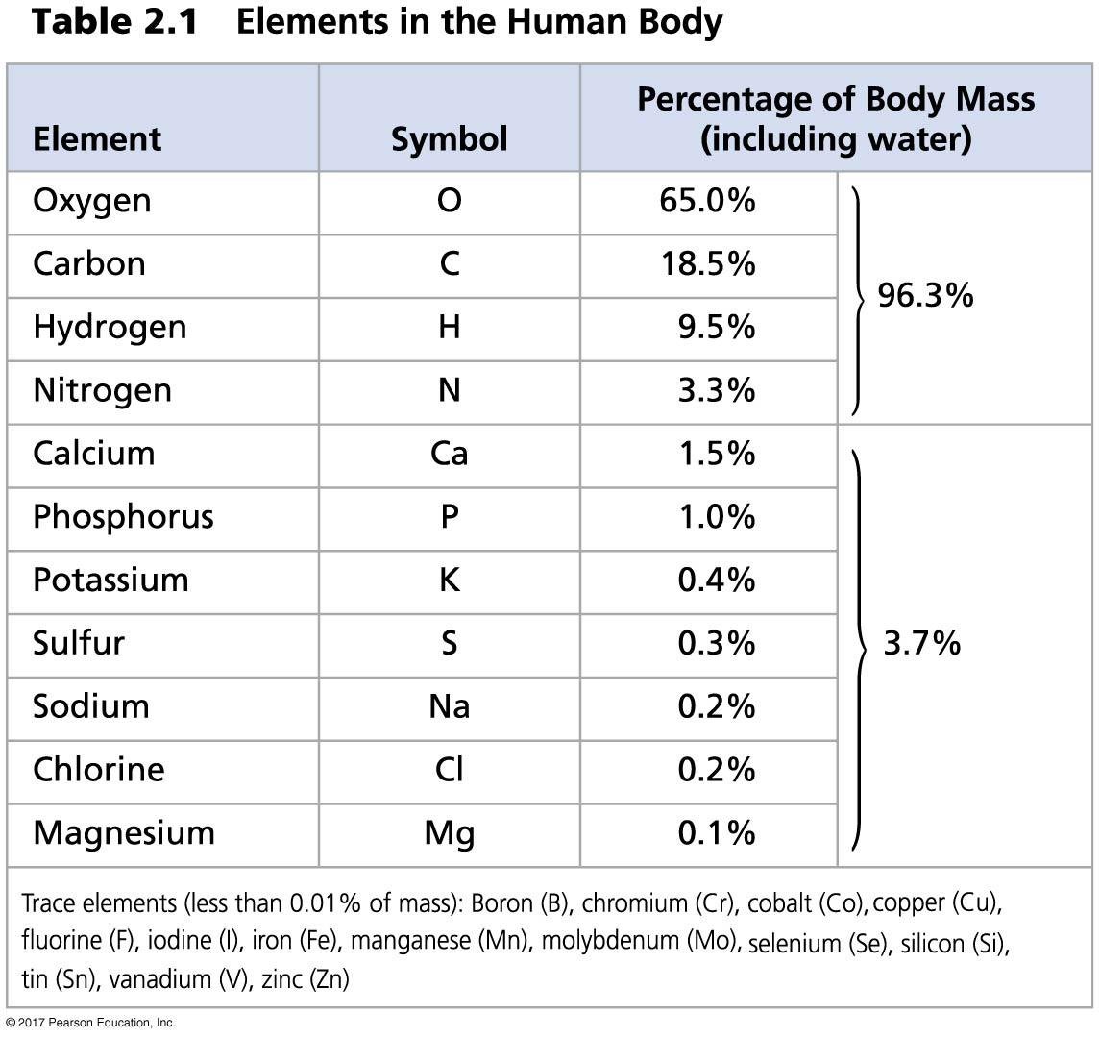
Table 2.1
Notes:
Table 2.1 Elements in the human body

Slide 4
Elements
There are 92 naturally occurring elements.
Only 12 elements are found in living organisms in substantial amounts.
Four elements make up 96.3% of human body weight:
- carbon, hydrogen, oxygen, nitrogen

Slide 5
Chemical Bonds
Molecules are groups of atoms held together in a stable association.
Compounds are molecules containing more than one type of element.
Atoms are held together in molecules or compounds by chemical bonds.

Slide 6
Atomic Structure
All matter is composed of atoms.
Understanding the structure of atoms is critical to understanding the nature of biological molecules.

Slide 7
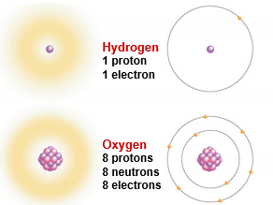
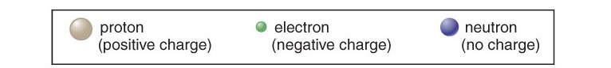
Atomic Structure
Atoms are composed of
-protons – positively charged particles
-neutrons – neutral particles
-electrons – negatively charged particles
Protons and neutrons are located in the nucleus. Electrons are found in orbitals surrounding the nucleus.

Slide 8
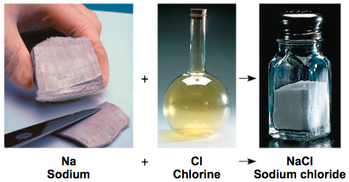
An element is a substance that cannot be broken down to other substances by chemical reactions
A compound is a substance consisting of two or more elements in a fixed ratio
A compound has characteristics different from those of its elements

Slide 9
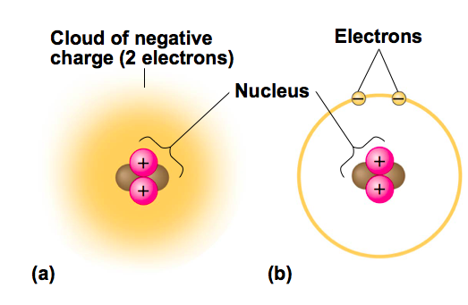
An element’s atomic number is the number of protons in its nucleus
An element’s mass number is the sum of protons plus neutrons in the nucleus
Atomic mass, the atom’s total mass, can be approximated by the mass number
Neutron mass and proton mass are almost identical and are measured in daltons

Slide 10
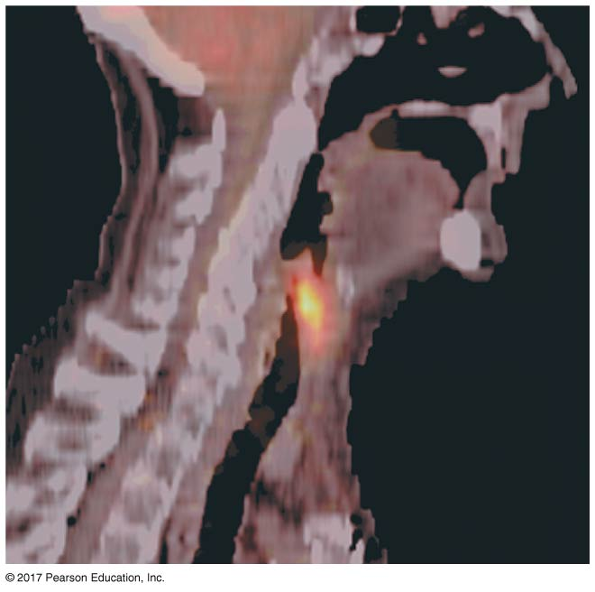
Isotopes
All atoms of an element have the same number of protons but may differ in number of neutrons
Isotopes are two atoms of an element that differ in number of neutrons
Radioactive isotopes decay spontaneously, giving off particles and energy
  used as diagnostic tools in medicine
  Radiometric dating

Slide 11
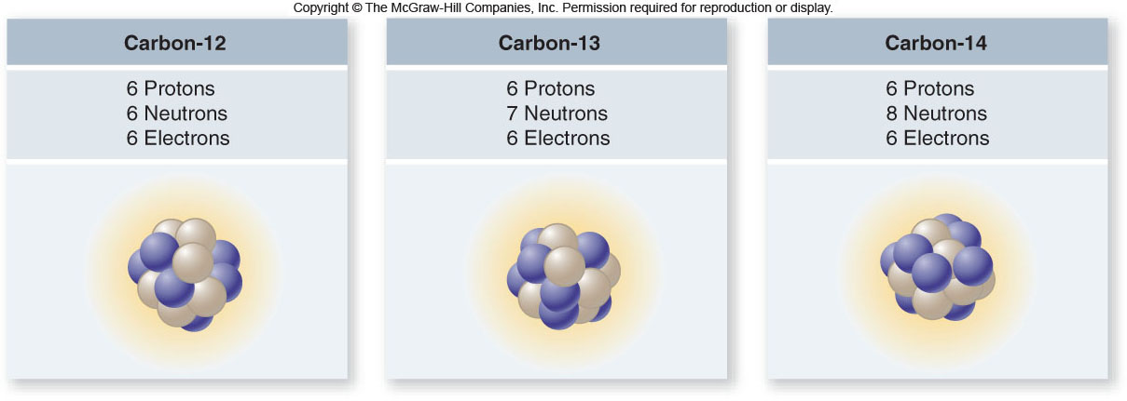
Atomic Structure

Slide 12
The Energy Levels of Electrons
Energy is the capacity to cause change
Potential energy is the energy that matter has because of its location or structure
The electrons of an atom differ in their amounts of potential energy
An electron’s state of potential energy is called its energy level, or electron shell

Slide 13
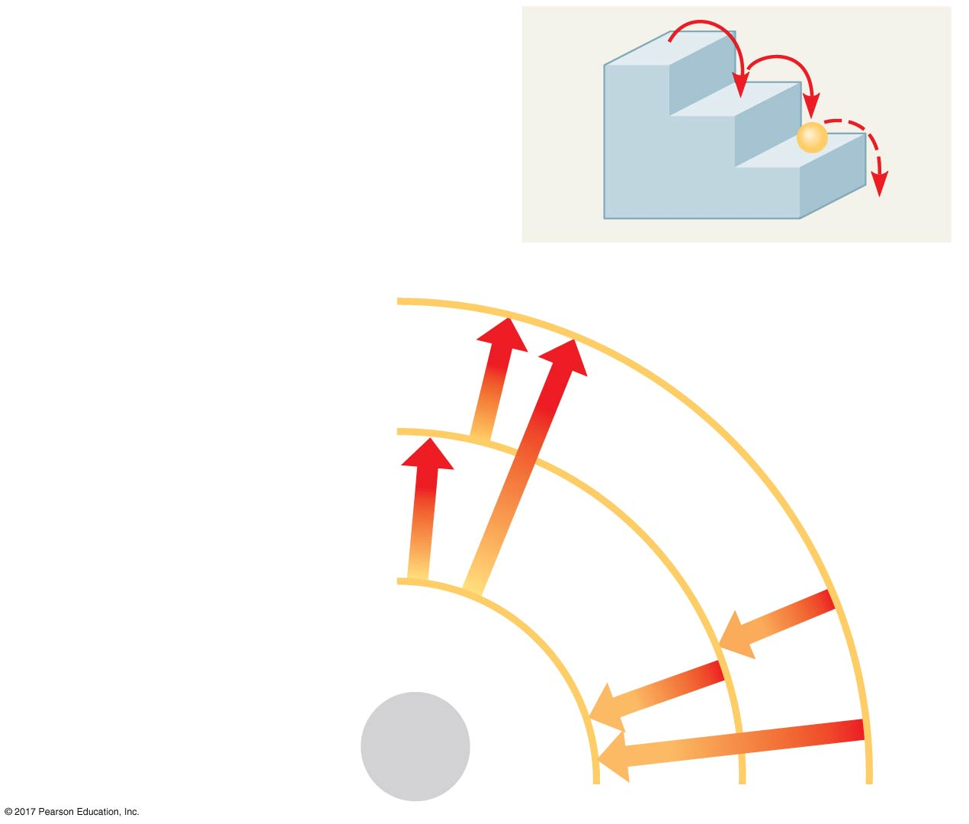
Figure 2.6
A ball bouncing down a flight
of stairs can come to rest only
on each step, not between steps.
Third shell (highest energy
level in this model)
Second shell (higher
energy level)
Energy
absorbed
First shell (lowest energy
level)
Energy
lost
Atomic
nucleus
(b)
Notes:
Figure 2.6 Energy levels of an atom’s electrons

Slide 14
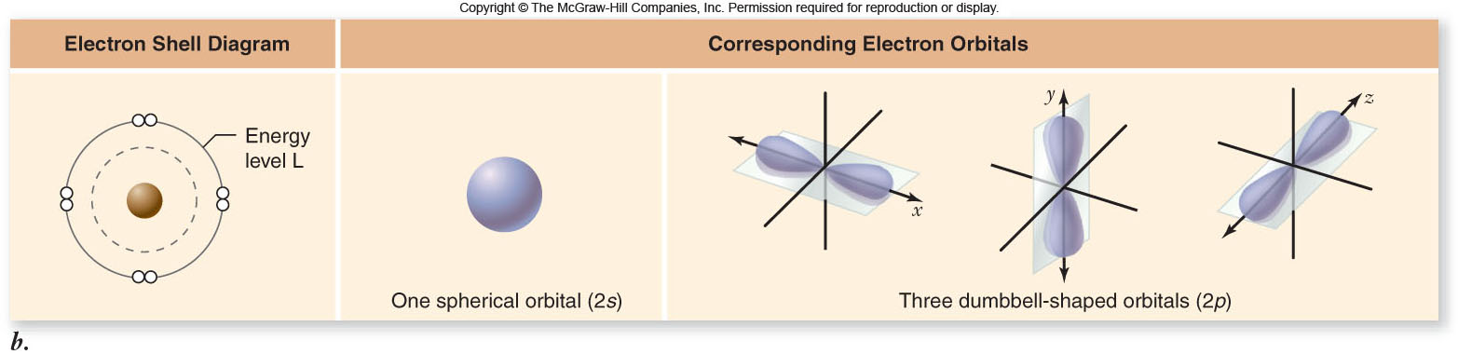
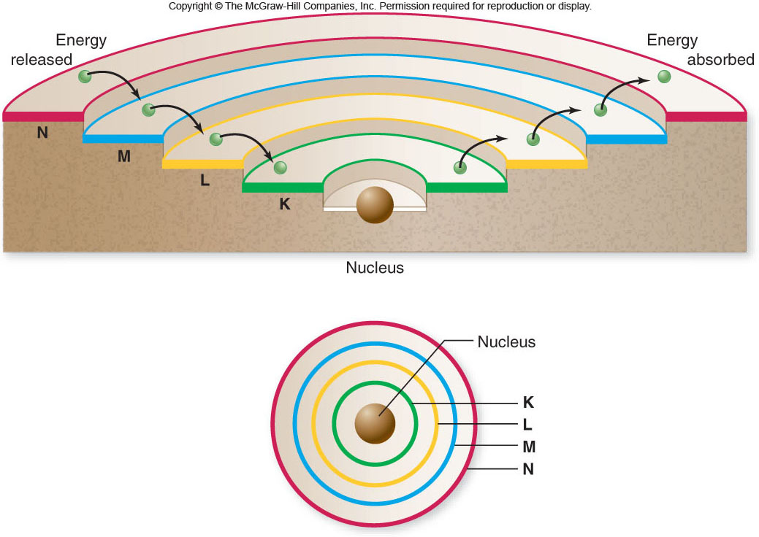
Atomic Structure

Slide 15
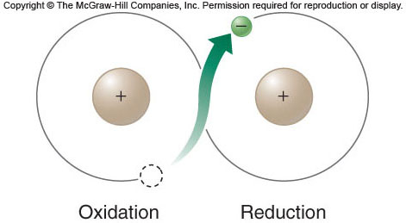
Atomic Structure
Electrons can be transferred from one atom to another, while still retaining the energy of their position in the atom.
-oxidation = loss of an electron
-reduction = gain of an electron

Slide 16
Bonding properties
Valence electrons are the electrons in the outermost energy level of an atom.
An element’s chemical properties depend on interactions between valence electrons of different atoms.
How does this
atom behave?

Slide 17
How does this atom behave?
Is it oxidizing or reducing?
How does this atom behave?
Is it oxidizing or reducing?
Notes:
Sulfur on the LEFT
Magnesium on the RIGHT

Slide 18
Elements
The Periodic Table arranges all elements according to their atomic number.
The table identifies elements with similar chemical properties.

Slide 19
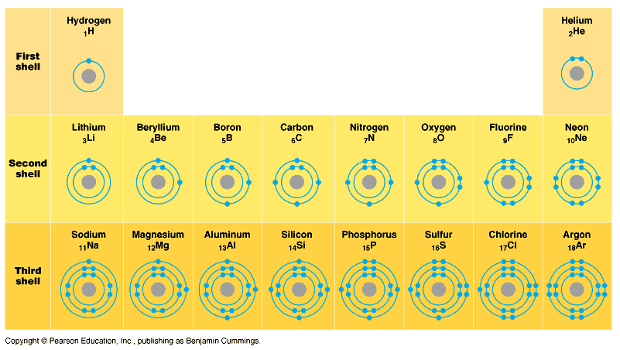
Elements & their valence shells
Elements in the same row have the same number of shells
Moving from left to right, each element has a sequential addition of electrons (& protons)

Slide 20
Elements & their valence shells
Elements in the same column have the same valence & similar chemical properties
Notes:
Oxygen has medium electronegativity so doesn’t
pull electrons all the way off hydrogen whereas
chlorine would.
So oxygen forms a polar covalent bond.
Carbon has only a weak electronegativity so forms a
nonpolar covalent bond

Slide 21
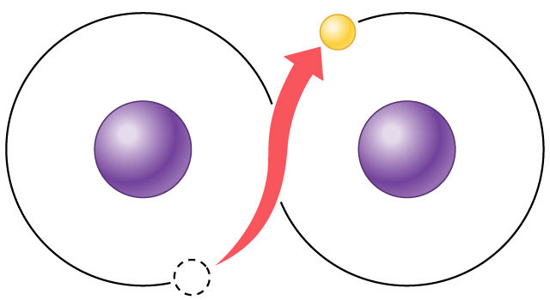
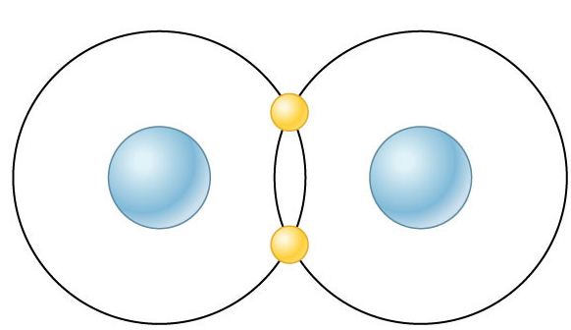
Chemical reactivity
Valence electrons are those in the outermost shell, or valence shell
Octet rule: Atoms tend to establish completely-full outer energy levels.
Atoms with full energy levels are less reactive than atoms with unfilled energy levels.
This tendency drives chemical reactions…
and creates bonds
–
–
–

Slide 22
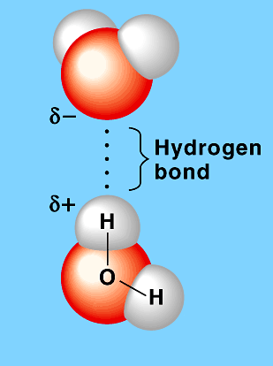
Bonds in Biology
Hydrogen bond
H₂O
Bonds between molecules
  hydrogen bonds
    attraction between + and –
  hydrophobic & hydrophilic interactions
  van derWaals forces
Bonds between atoms
  covalent bonds share electrons
  Ionic transfer electrons
H₂O
Covalent bond
–
–
H₂ (hydrogen gas)

Slide 23
Ionic Bonds
Atoms sometimes strip electrons from their bonding partners
An example is the transfer of an electron from sodium to chlorine
After the transfer of an electron, both atoms have charges
A charged atom (or molecule) is called an ion

Slide 24
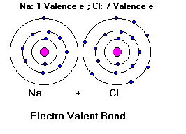

IONIC BONDING: transfer of electrons
Metal-nonmetal
Transfer of electrons always results in a polar bond and a polar molecules.
Cation: (+) loss of electrons Na⁺
Anion (-) gain of electrons Cl⁻
After the transfer of an electron, both atoms have charges
A charged atom (or molecule) is called an ion

Slide 25
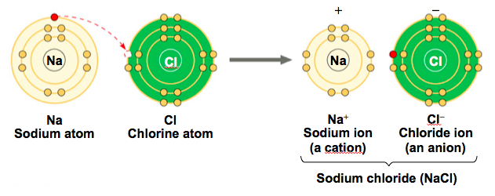
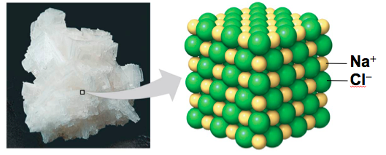

Slide 26
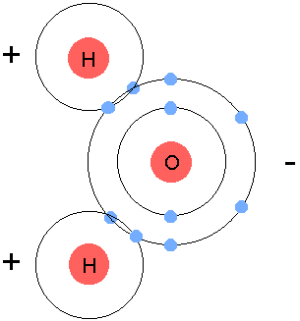
COVALENT BONDING: sharing of electrons
Nonmetal-nonmetal
Pair of electrons shared unequally = polar bond
H₂O
(molecular formula)
O
H
H
Polar molecule
(structural formula)
Electronegativity: the ability to attract electrons
The more electronegative an atom is, the more strongly it pulls shared electrons toward itself

Slide 27
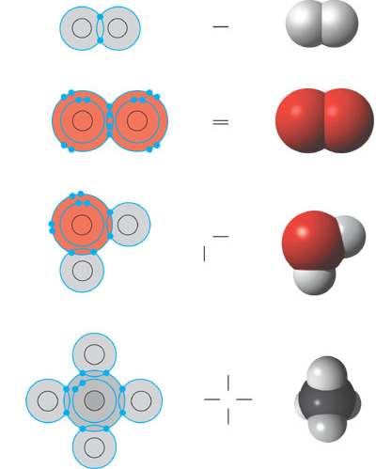
Multiple covalent bonds
2 atoms can share >1 pair of electrons
  double bonds
    2 pairs of electrons
  triple bonds
    3 pairs of electrons
Very strong bonds
More is
better!
H
–
H–C–H
–
H

Slide 28
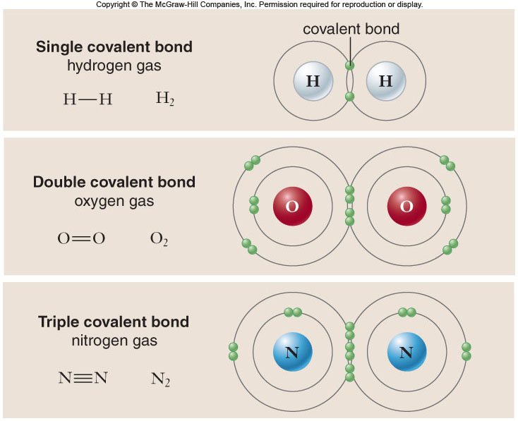
Covalent Bonds

Slide 29
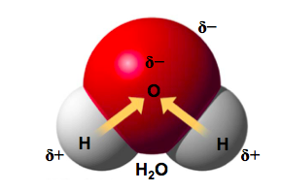
Differences in electronegativity dictate how electrons are distributed in covalent bonds.
- nonpolar covalent bonds = equal sharing of electrons
- polar covalent bonds = unequal sharing of electrons

Slide 30
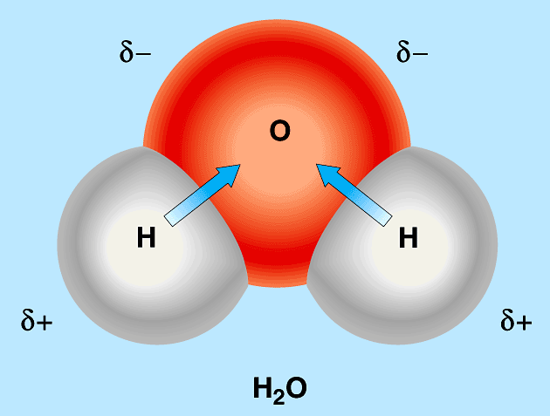
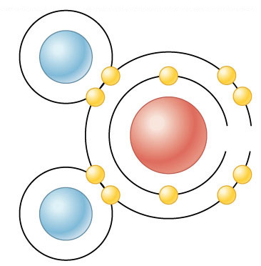
Polar covalent bonds
Pair of electrons shared unequally by 2 atoms
Water = O + H
  oxygen has stronger “attraction” for the electrons than hydrogen
  oxygen has higher electronegativity
  water is a polar molecule
    + vs – poles
    leads to many interesting properties of water…
+
–
H
–
Oxygen
H
–
+
–

Slide 31
Weak Chemical Interactions
Most of the strongest bonds in organisms are covalent bonds that form a cell’s molecules
Many large biological molecules are held in their functional form by weak bonds
The reversibility of weak bonds can be an advantage

Slide 32
Hydrogen Bonds
Within a water molecule, the bonds between oxygen and hydrogen are highly polar
  oxygen is partially negative
  hydrogen is partially positive
Hydrogen bonds are weak attractions between the partially negative oxygen of one water molecule and the partially positive hydrogen of a different water molecule.
  Hydrogen bonds can form between water molecules or between water and another charged molecule.

Slide 33
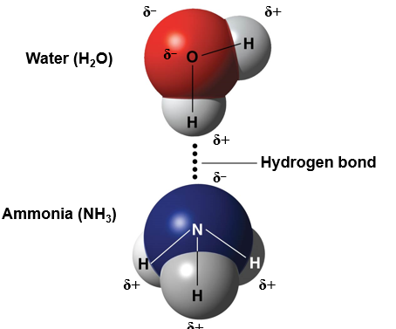
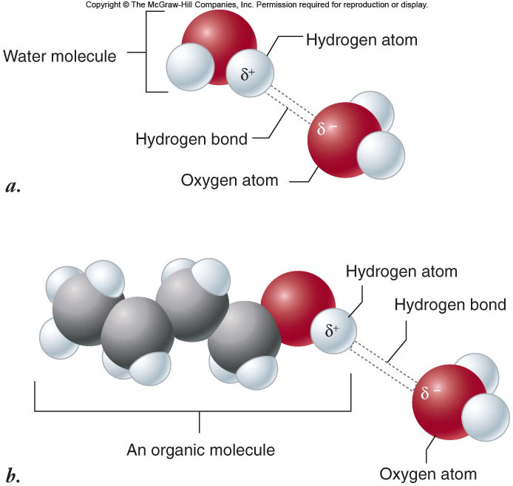

Slide 34
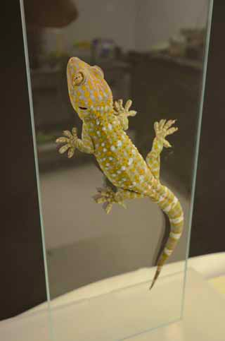

Van der Waals Interactions
If electrons are not evenly distributed, they may accumulate by chance in one part of a molecule
Van der Waals interactions are attractions between molecules that are close together as a result of these charges
Collectively, such interactions can be strong, as between molecules of a gecko’s toe hairs and a wall surface

Slide 35
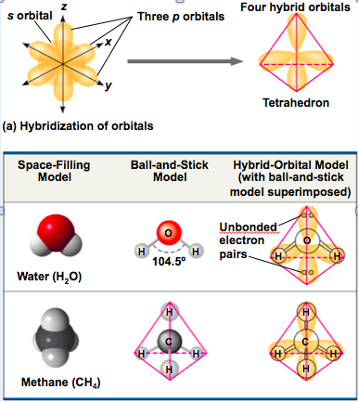
Molecular Shape and Function
A molecule’s size and shape are key to its function
A molecule’s shape is determined by the positions of its atoms’ orbitals

Slide 36
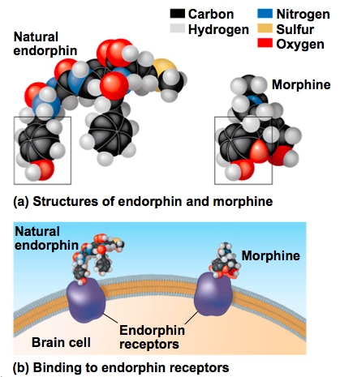
Molecular shape determines how biological molecules recognize and respond to one another
Opiates, such as morphine, and naturally produced endorphins have similar effects because their shapes are similar and they bind the same receptors in the brain

Slide 37
Concept 2.4: Chemical reactions make and break chemical bonds
Chemical reactions are the making and breaking of chemical bonds
The starting molecules of a chemical reaction are called reactants
The final molecules of a chemical reaction are called products
Whether a chemical reaction occurs is influenced by
-temperature
-concentration of reactants and products
-availability of a catalyst

Slide 38
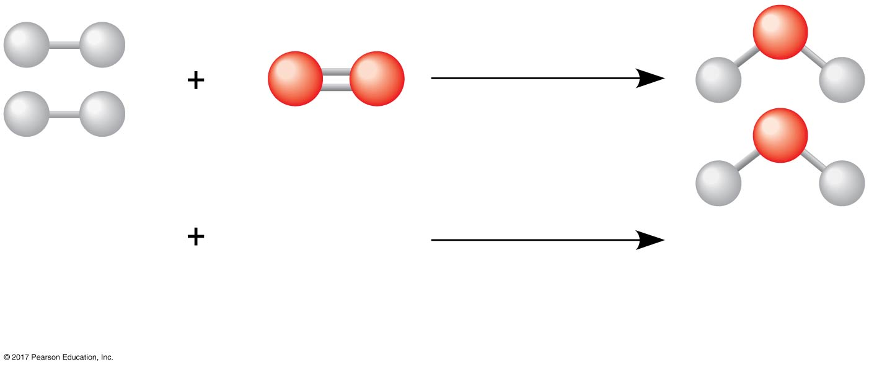
Figure 2.UN03
2 H₂
O₂
2 H₂O
Reactants
Chemical
reaction
Products
Notes:
Figure 2.UN03 In-text figure, water formation, p. 40

Slide 39
All chemical reactions are reversible: Products of the forward reaction become reactants for the reverse reaction
The two opposite-headed arrows indicate that a reaction is reversible
3 H₂ + N ⇌ 2 NH₃
Chemical equilibrium is reached when the forward and reverse reactions occur at the same rate
At equilibrium the relative concentrations of reactants and products do not change

